Slide 1
Coronary Heart Disease and Risk Factors in Oklahoma
Vahan Boyajyan
HMP 703 Final
December 13, 2023

Slide 2
Background and Objectives
Coronary heart disease is a type of heart disease where the arteries of the heart cannot deliver enough oxygen-rich blood to the heart.
According to the Centers for Disease Control and Prevention (CDC) the State of Oklahoma had the highest rate of heart disease mortality in 2021
Multiple risk factors may lead to the development Coronary Heart Disease (CHD):
Behavioral risk factors (not limited to):
Smoking
Diet
Physical activity
Socioeconomic factors (not limited to):
Poverty
Racial and ethnic discrimination
Access to Healthcare:
Objectives
Observe geographic distinctions of Coronary Heart Disease and Heart Disease Mortality across Oklahoma counties and census tracts
Examine the influence of Smoking and Obesity on the prevalence of CHD
Explore the prevalence of CHD in counties and census tracts with different poverty level and racial/ethnic distribution
Explore the availability of health care facilities in some counties
Study the effect of sports facilities on the prevalence of the CHD

Slide 3
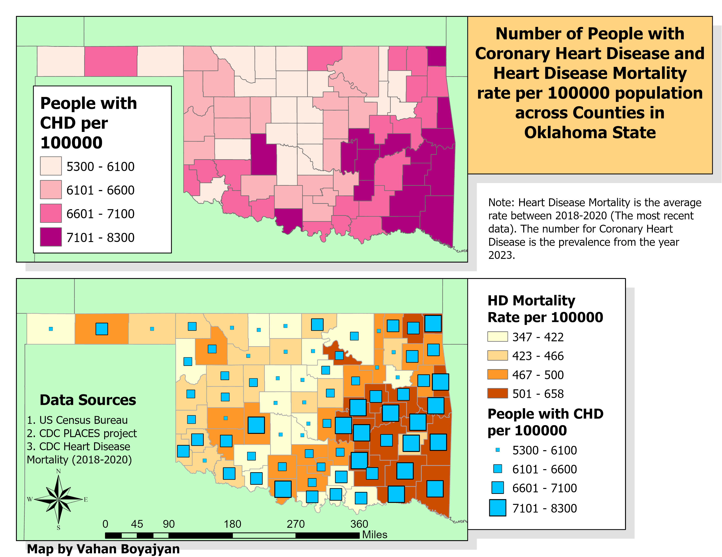

Slide 4
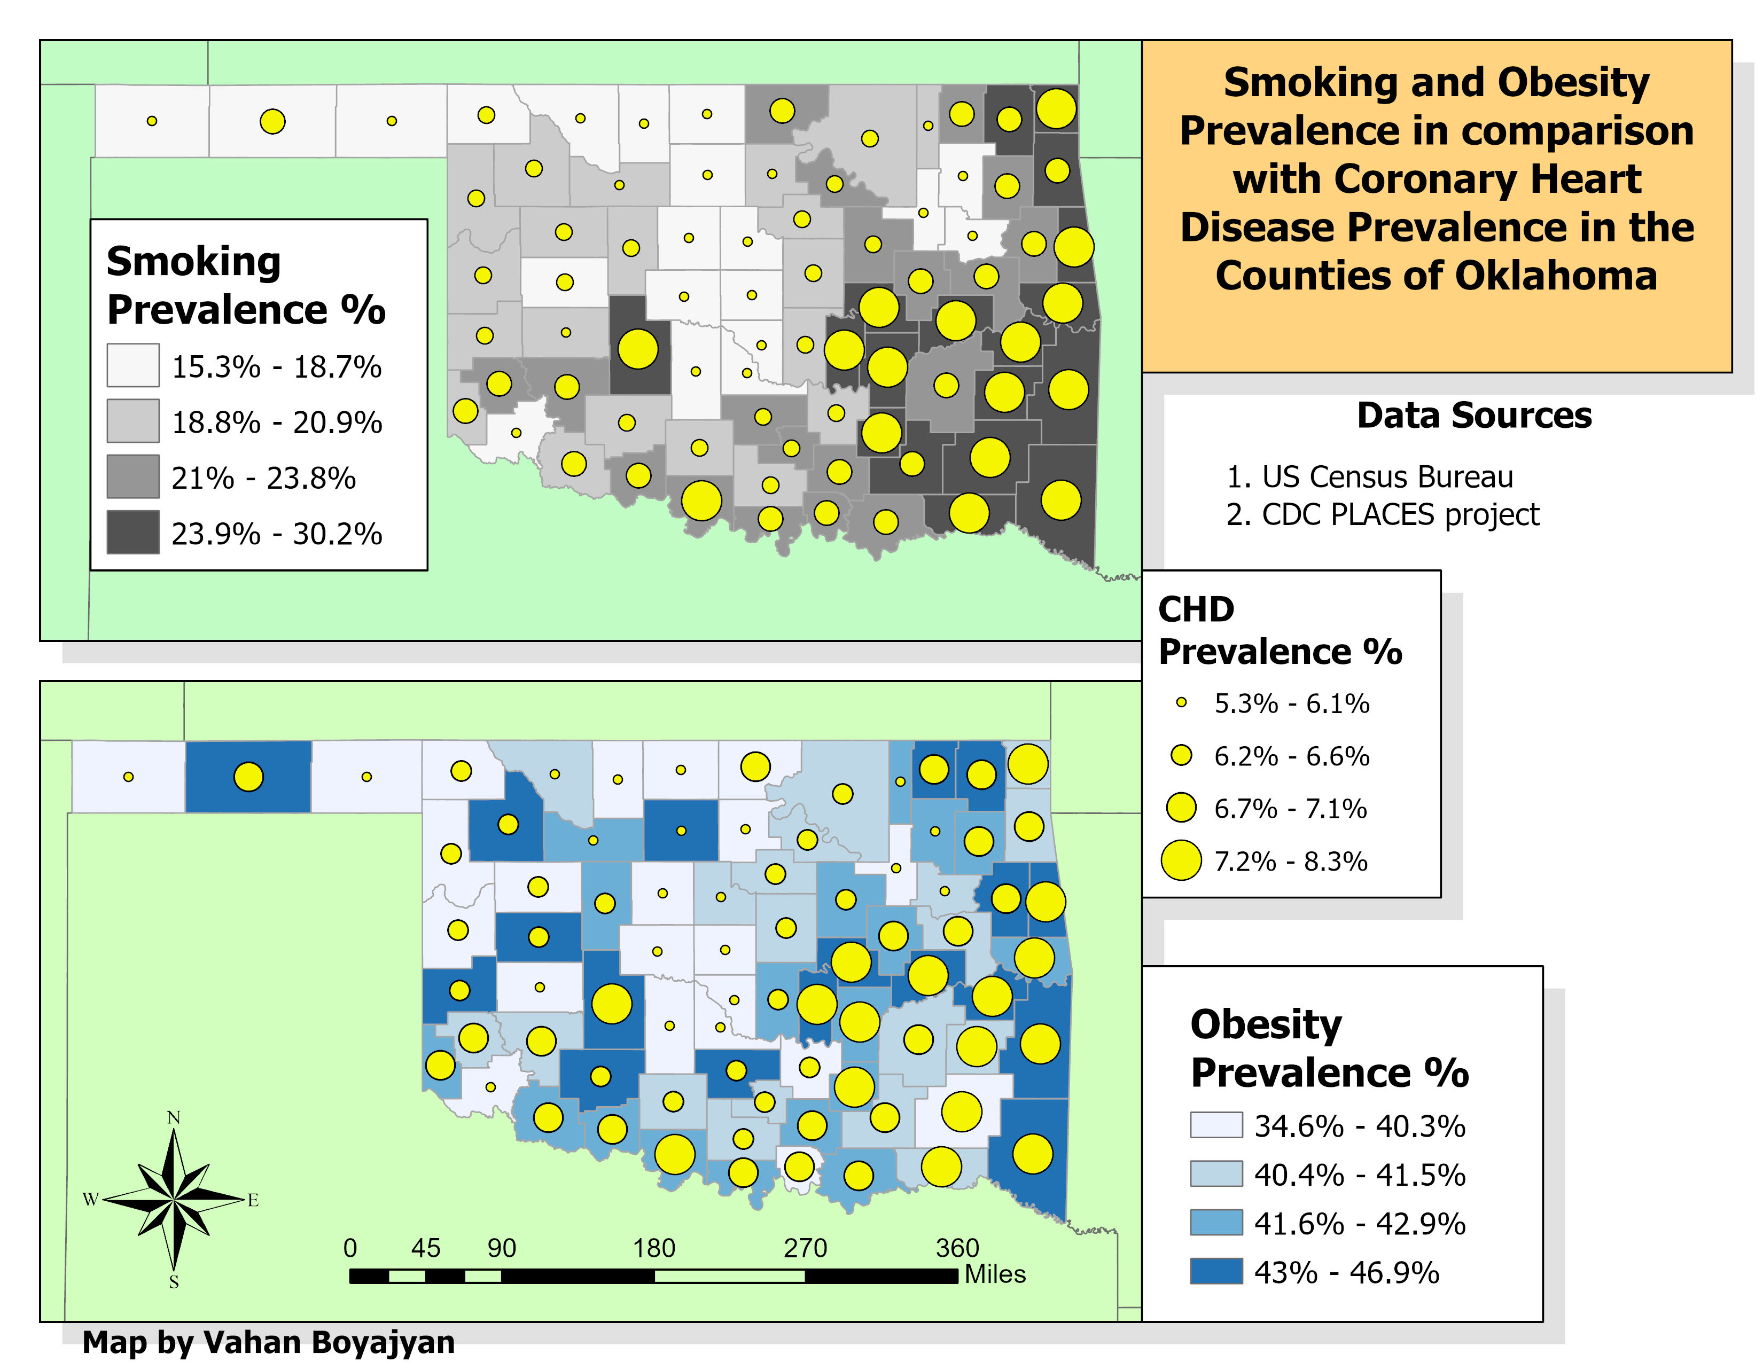

Slide 5
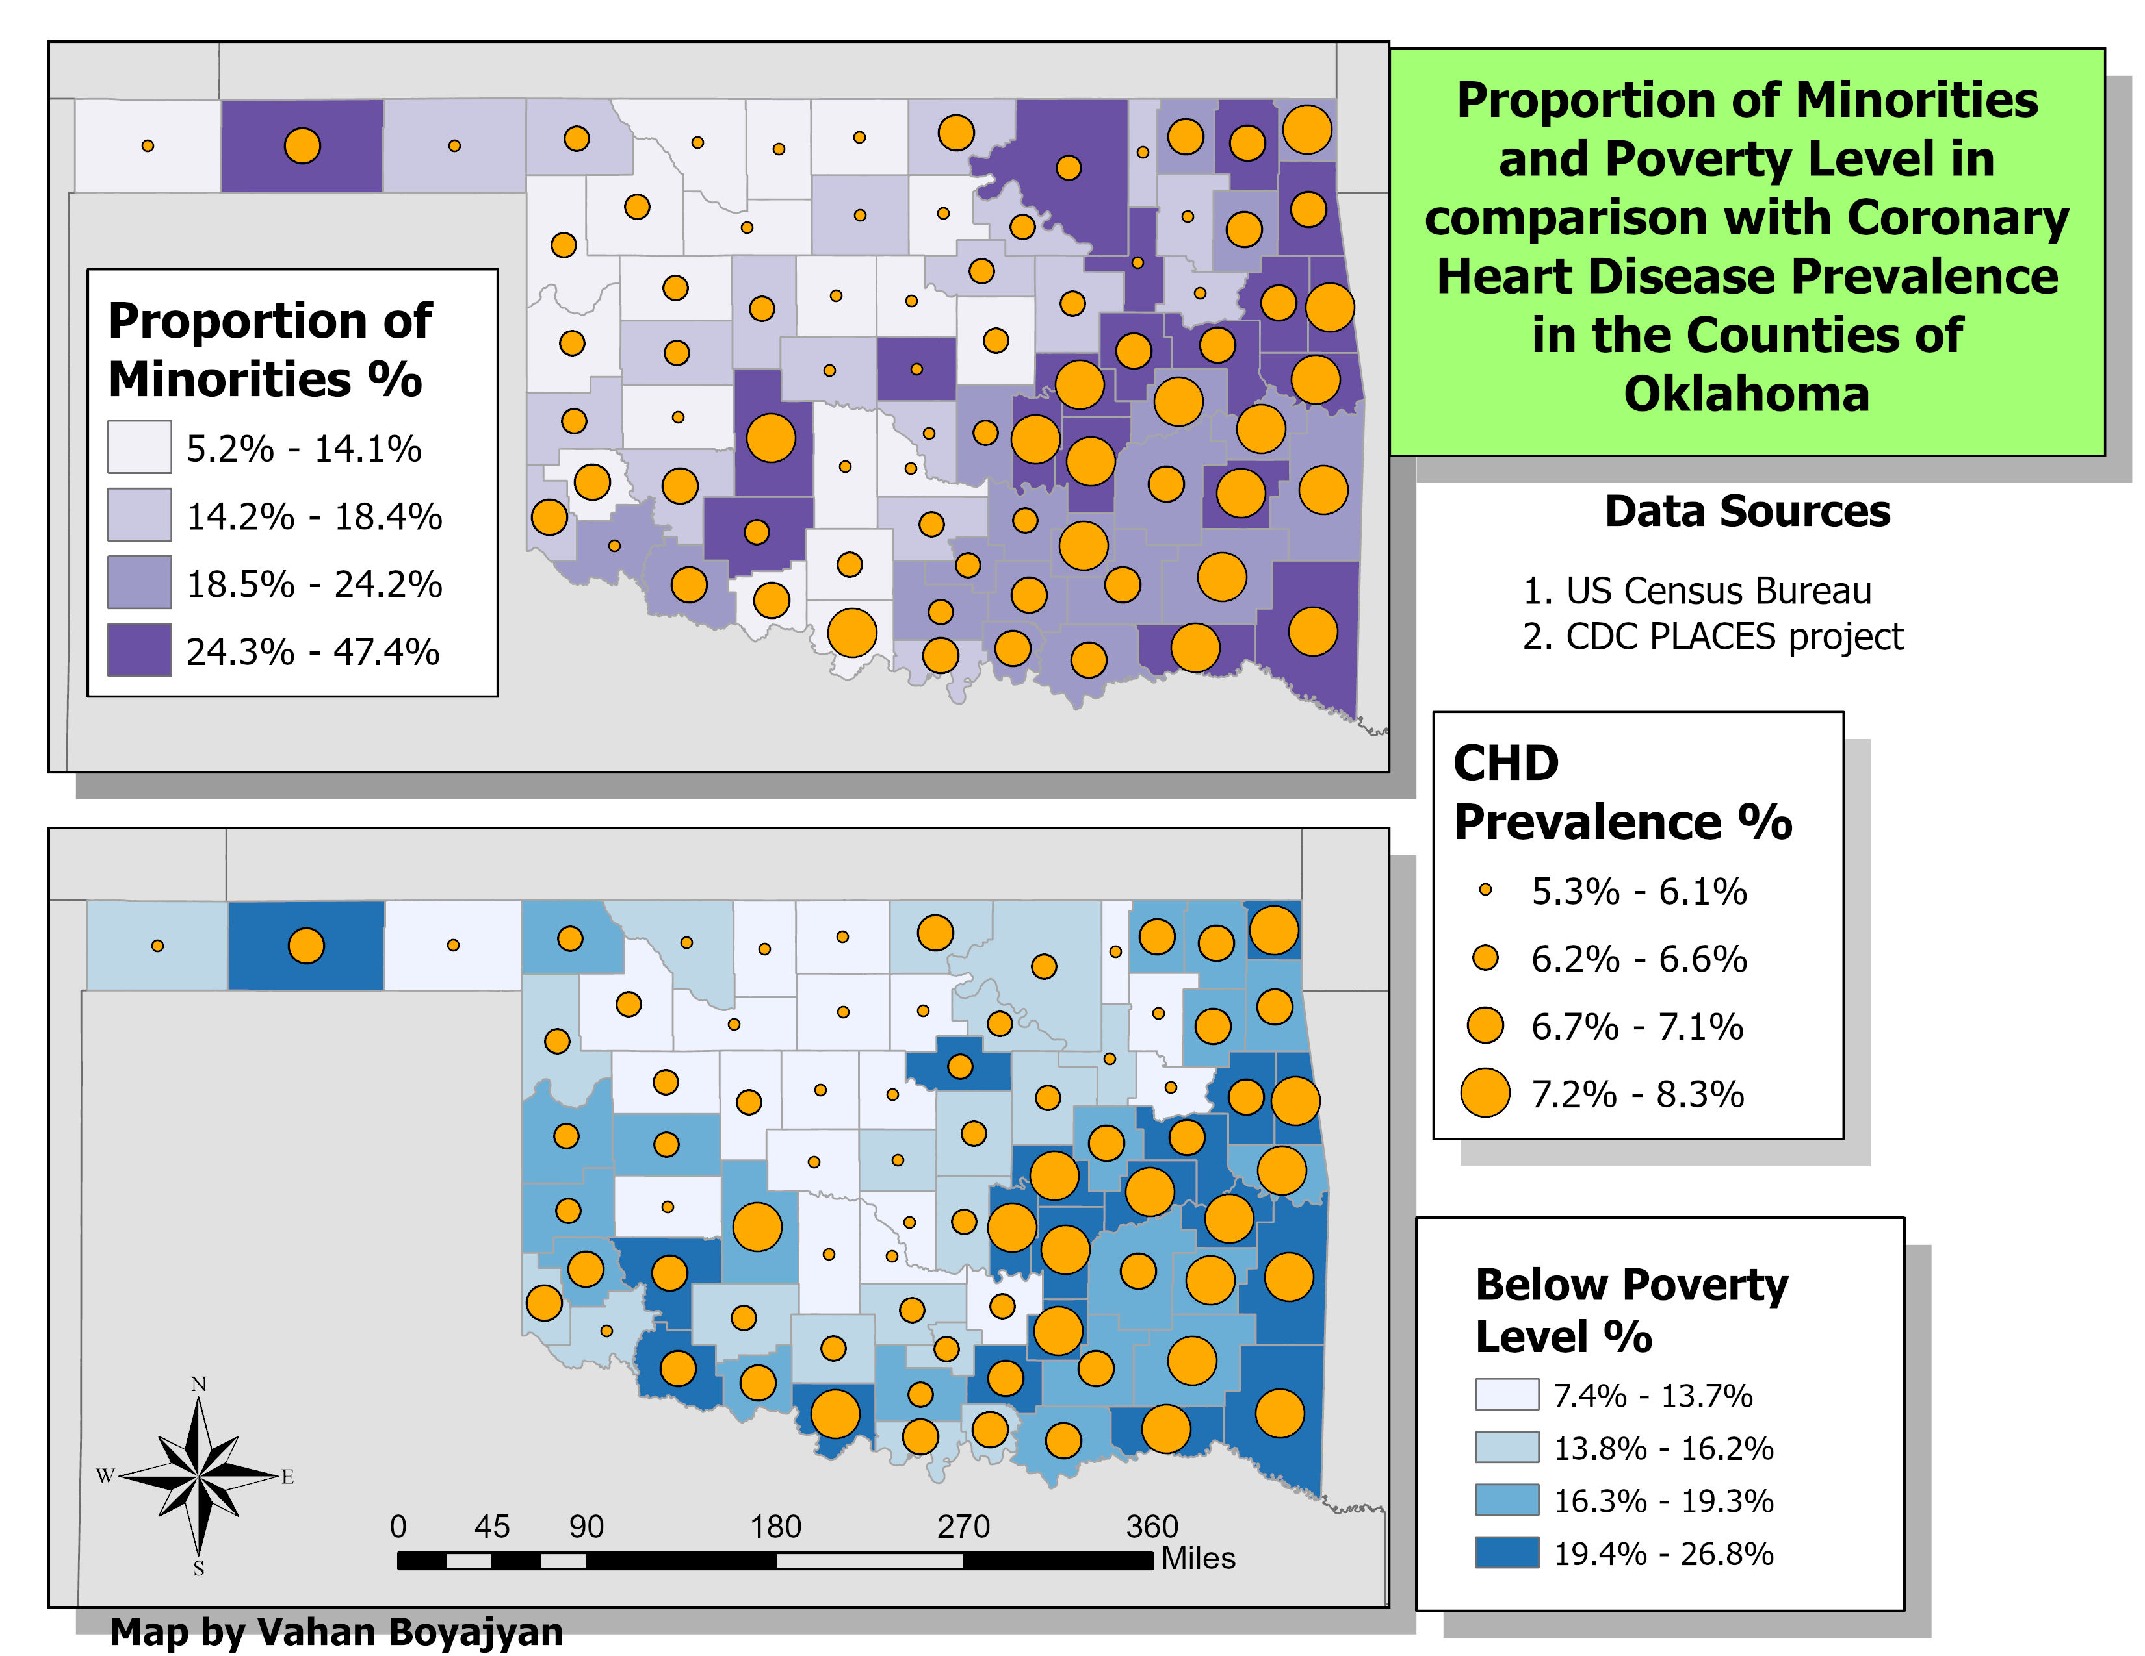

Slide 6
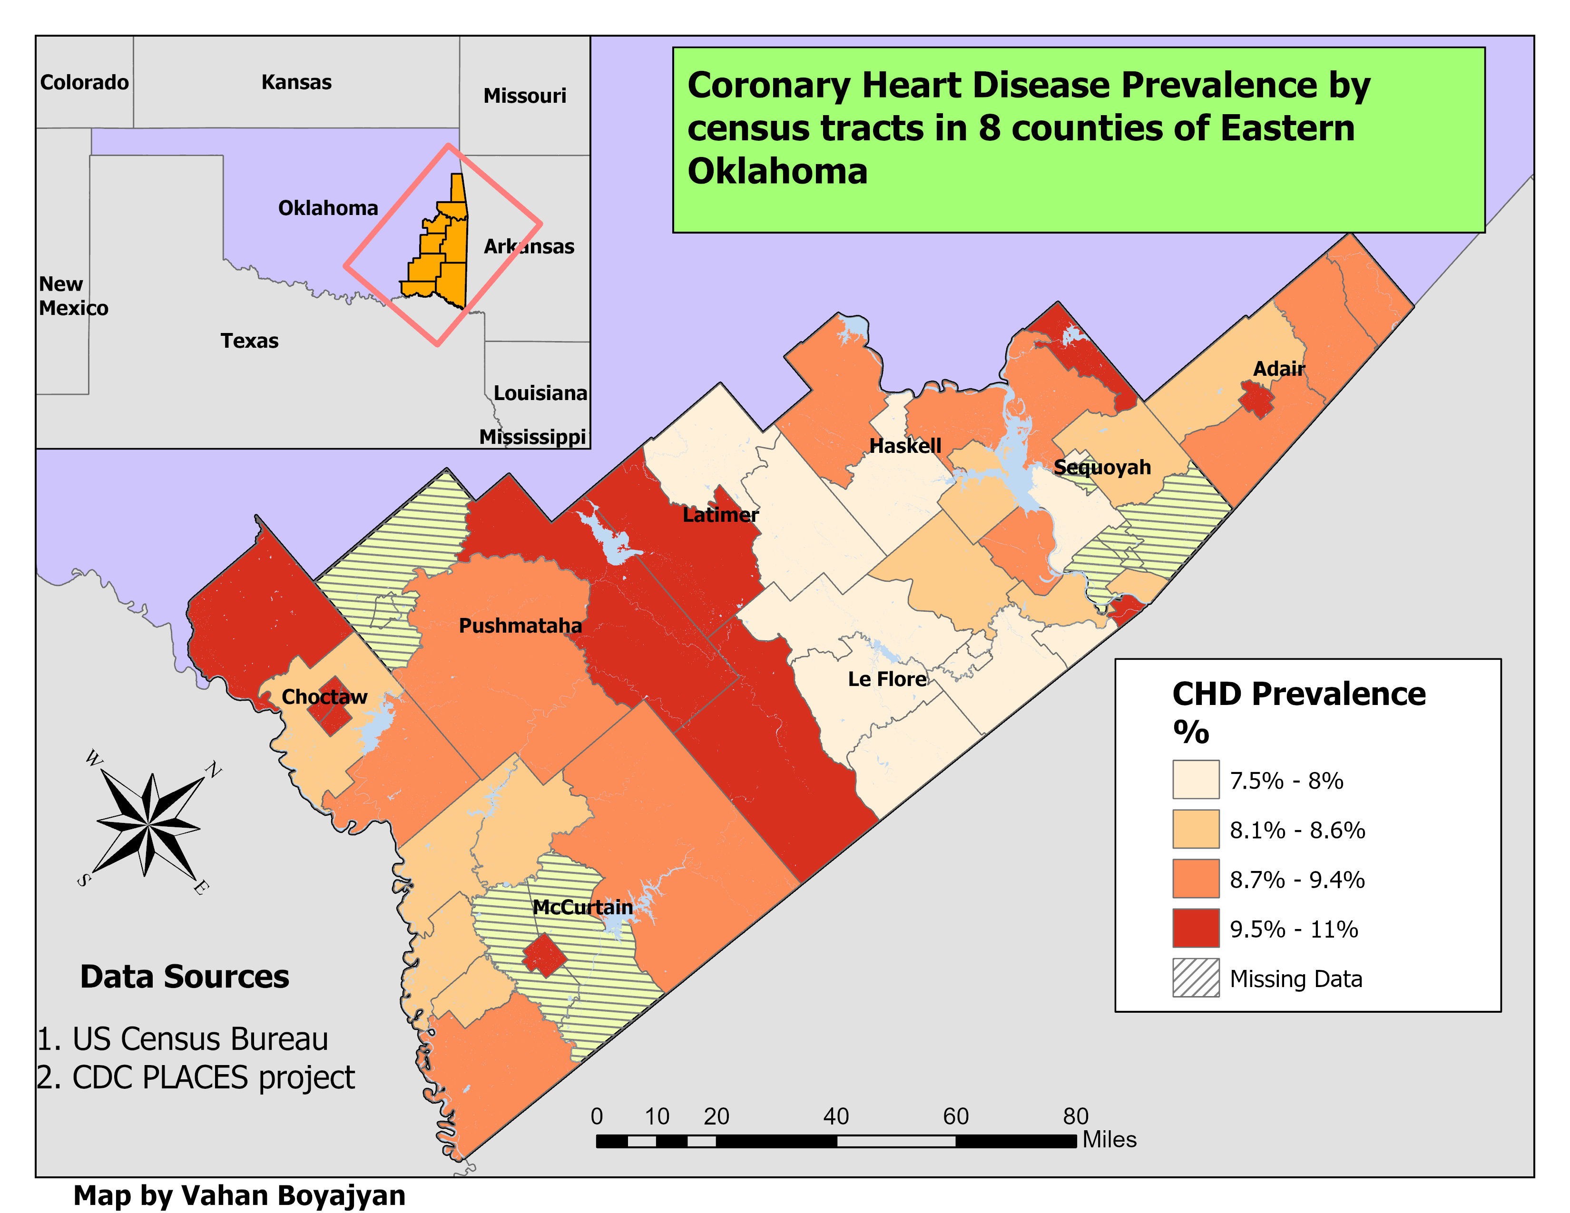

Slide 7
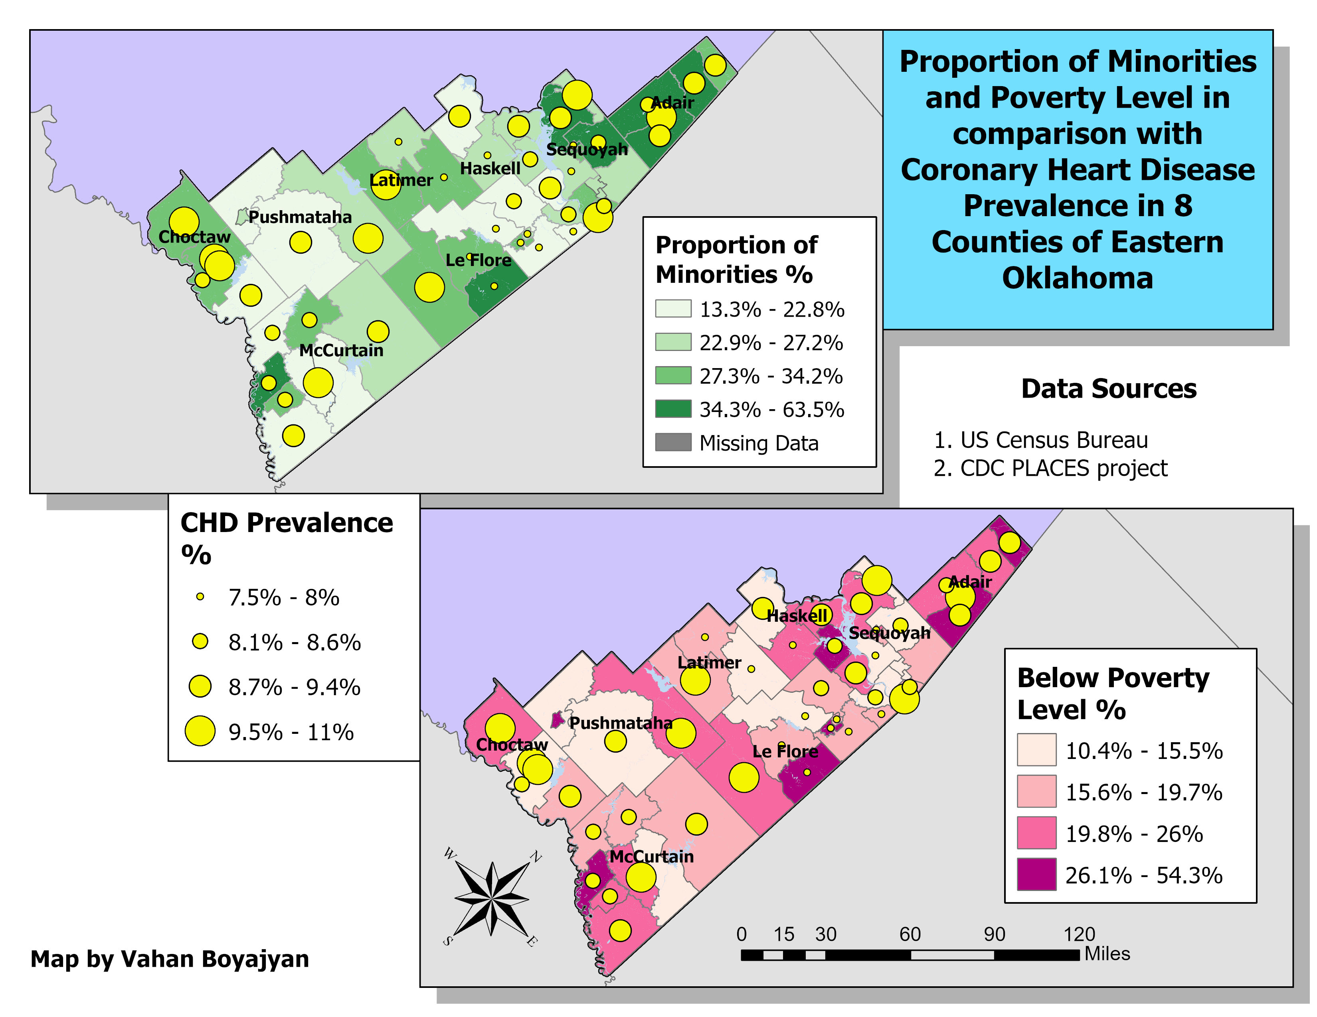

Slide 8
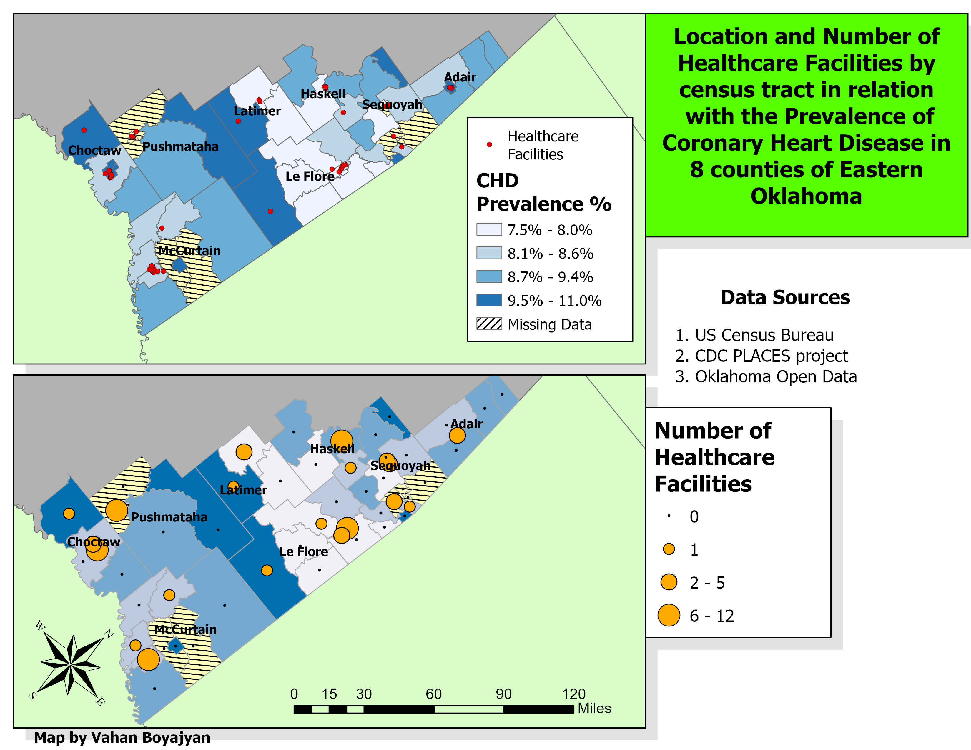

Slide 9
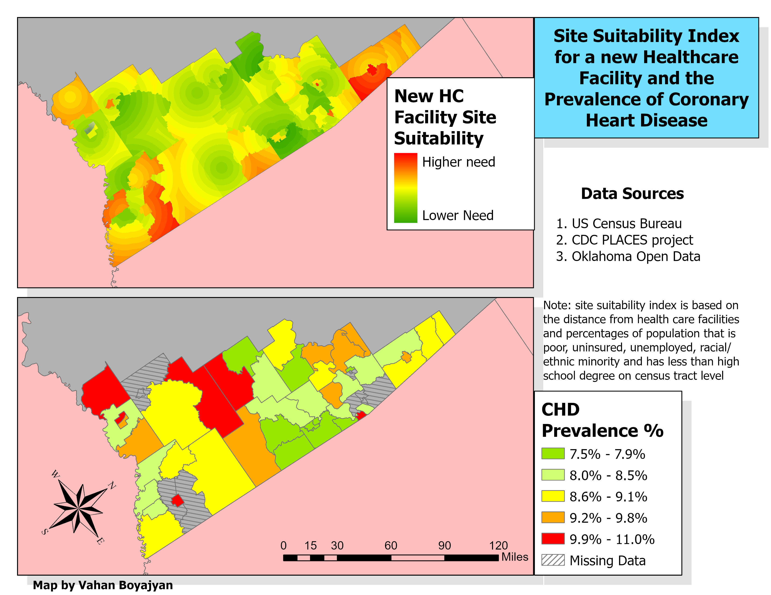

Slide 10
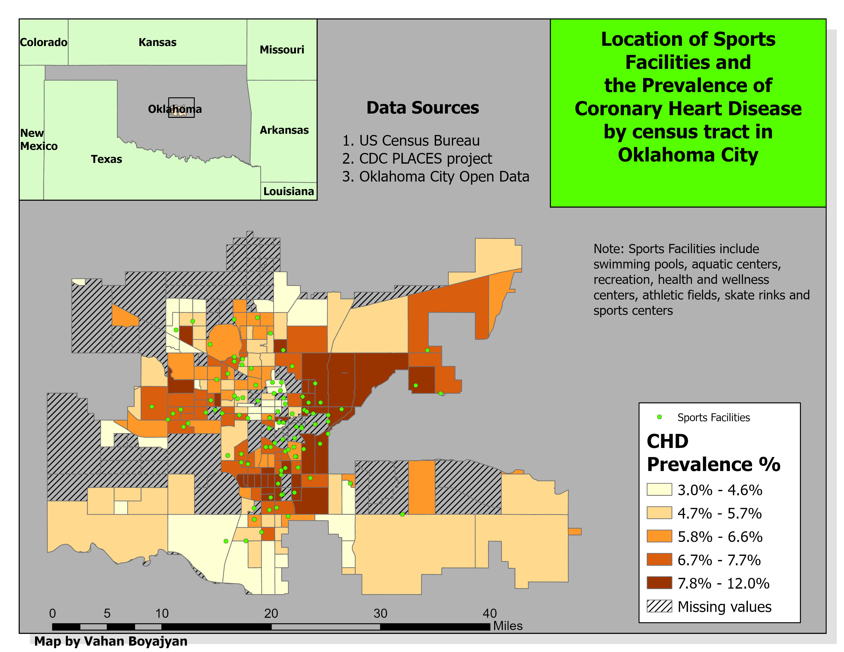

Slide 11
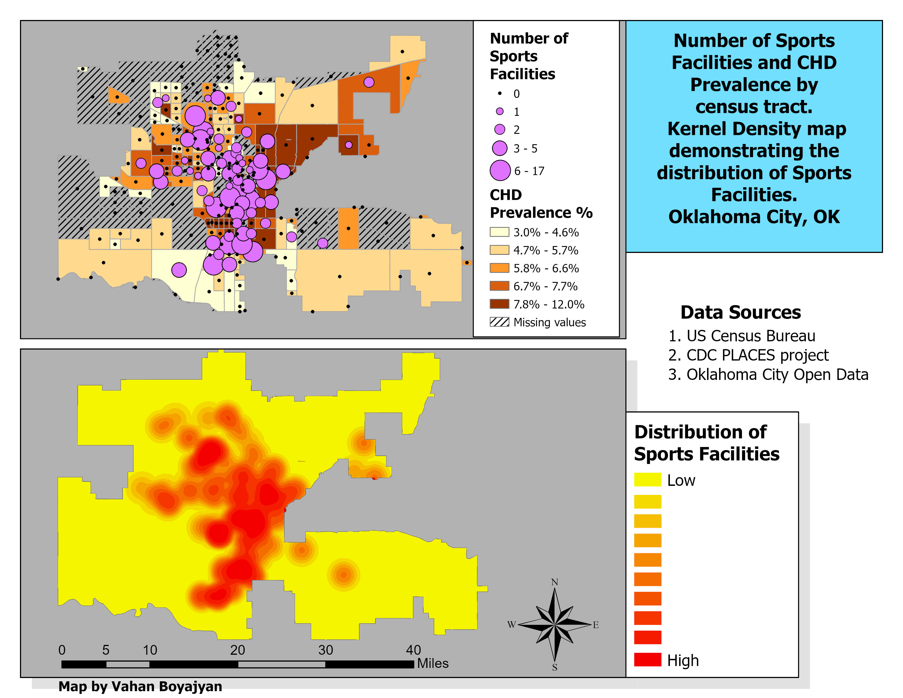

Slide 12
Elements and Skills
Inset Map: 6,10*
Point Graduated Symbols: 3, 4, 5, 7, 8, 11
Create a variable with field calculator: 3, 5, 6, 9
Select by attributes: 6, 10
Select by Location: 6, 8
Geoprocessing (Clip): 3, 10
Geoprocessing (Merge): 7, 8, 10
Join: 3, 5, 6, 7, 9
Spatial Join: 8, 11
Metadata: 4, 6 (see the following slides)
Address Geocoding (Original Shapefile): 8, 10 (see the following slides)
X,Y Table to Point (Original Shapefile): 8
Model: 9 (See the following slides)
Site Suitability Index in Spatial Analyst: 9
Kernel Density Map in Spatial Analyst : 11
*All numbers represent the slides

Slide 13
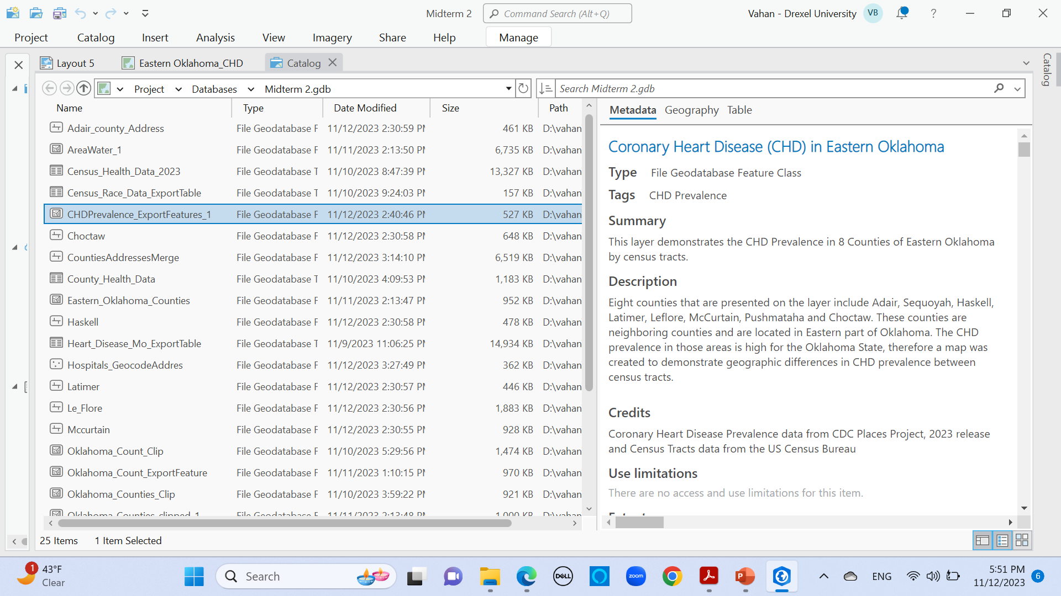

Slide 14
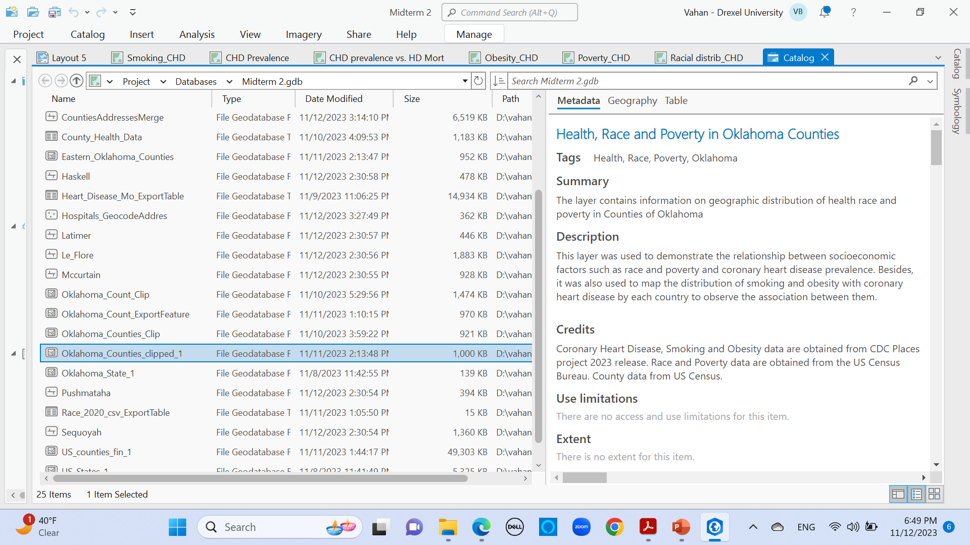

Slide 15
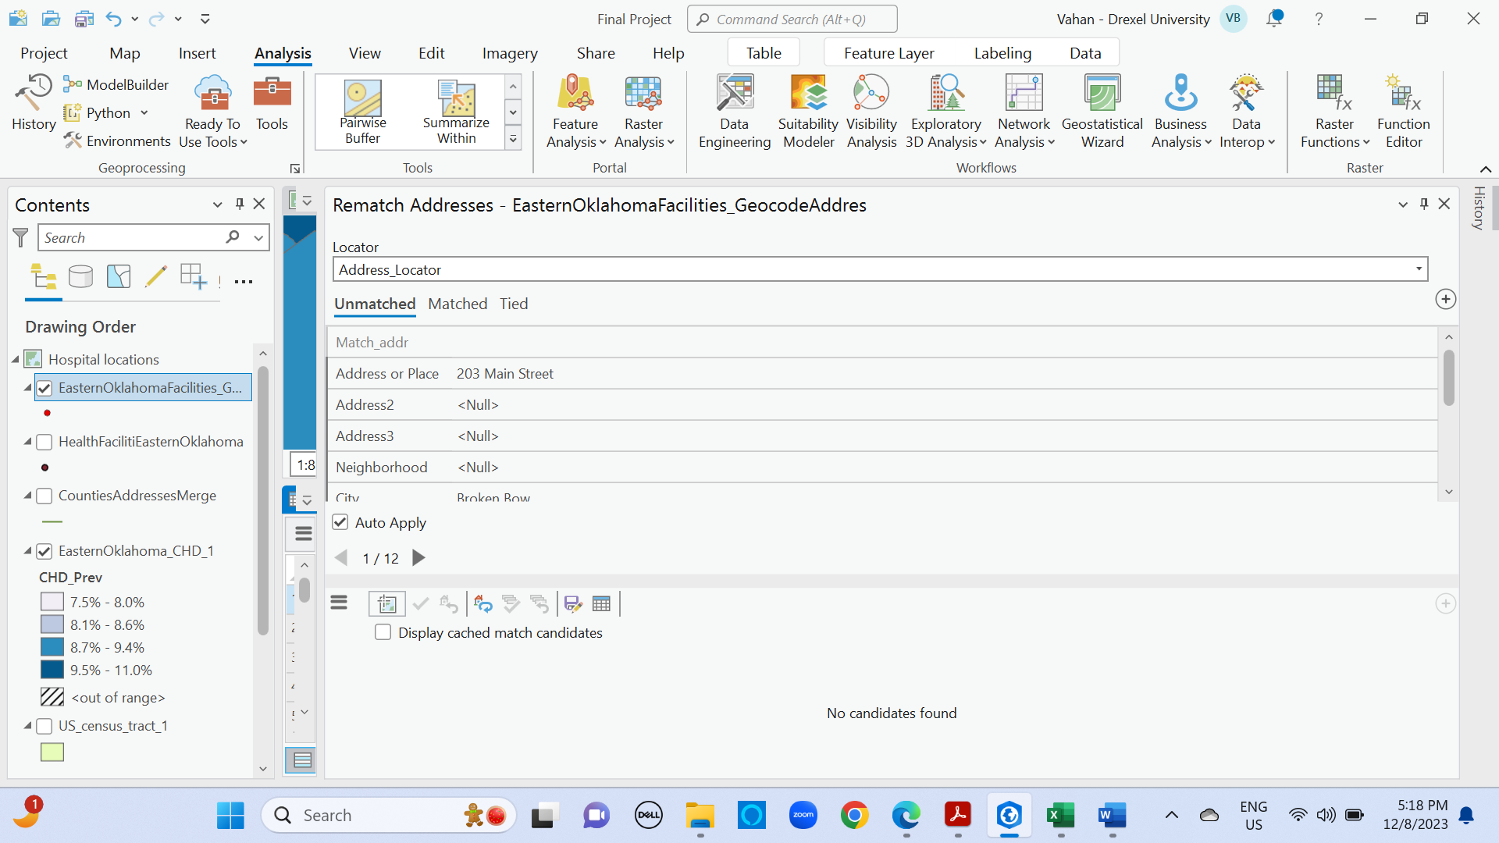
Address Geocoding for Health Care Facilities in Eastern Oklahoma

Slide 16
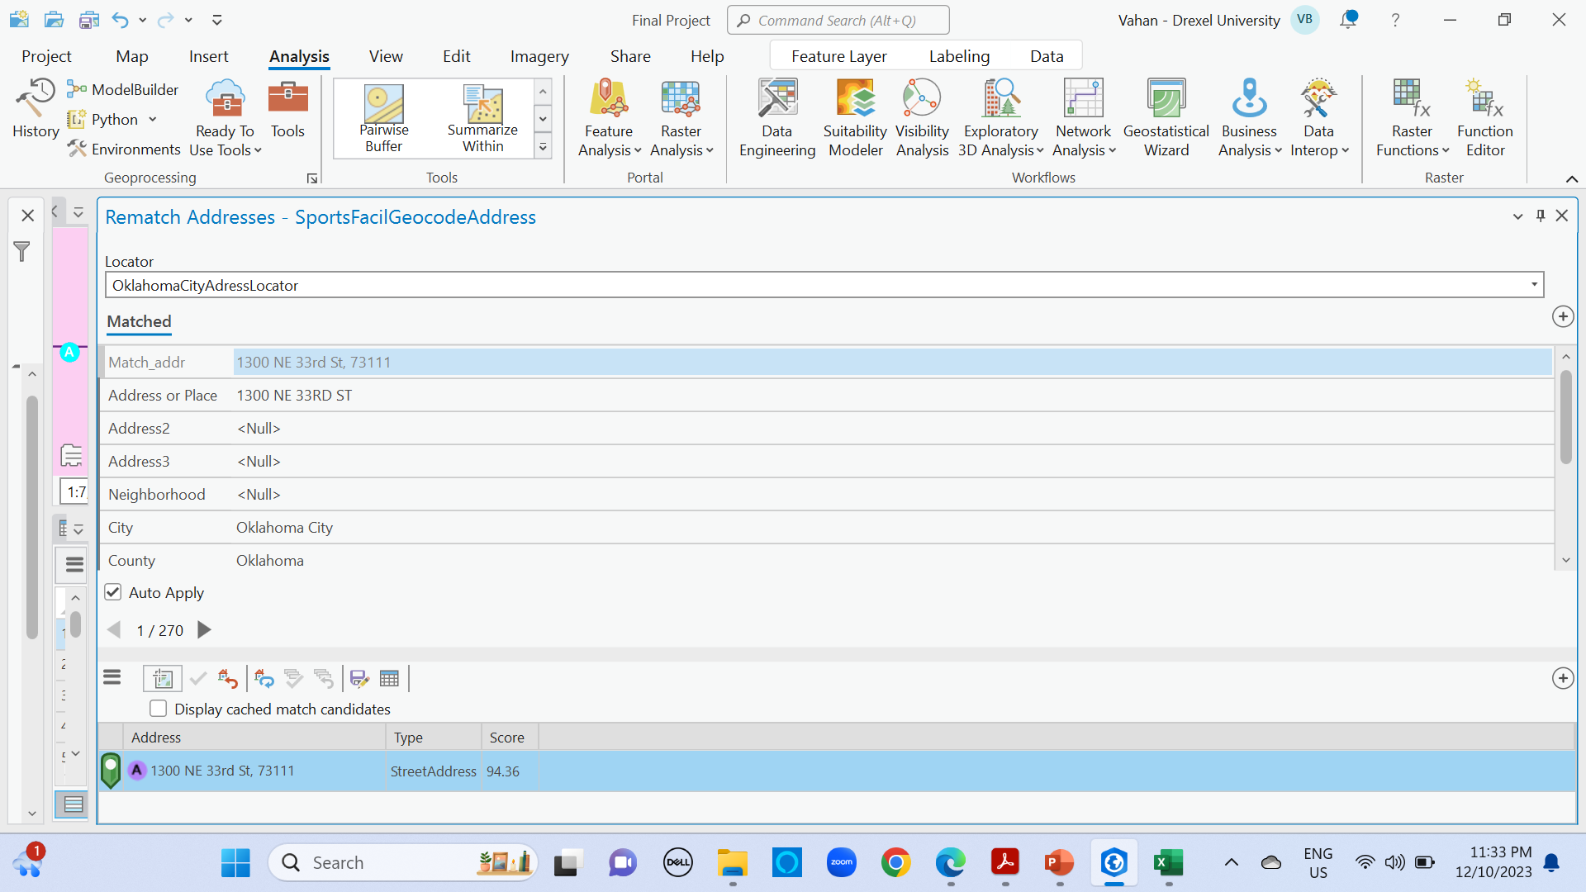
Address Geocoding for Sports Facilities in Oklahoma City

Slide 17
